Slide 1

BOARD GOVERNANCE
ORIENTATION
JIM CROCKER • BOARDROOM METRICS

Slide 2
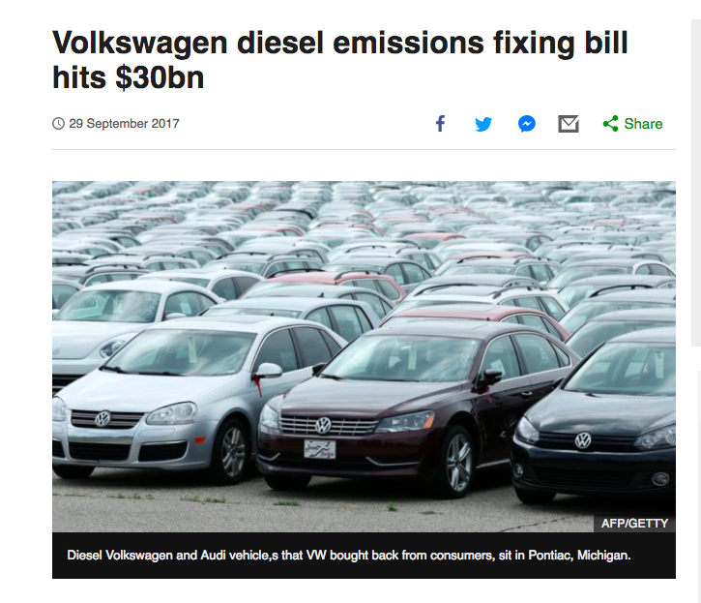
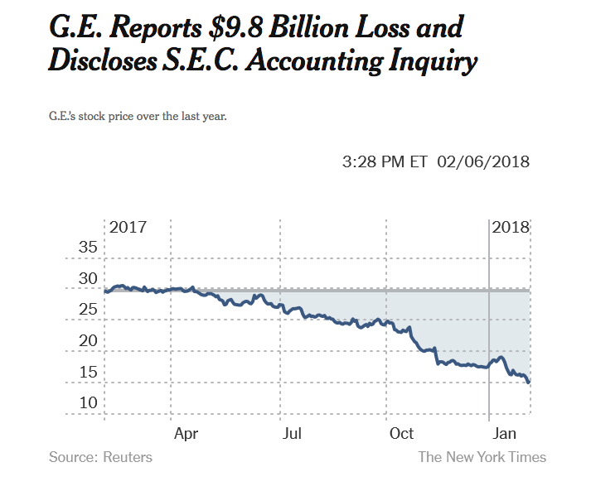

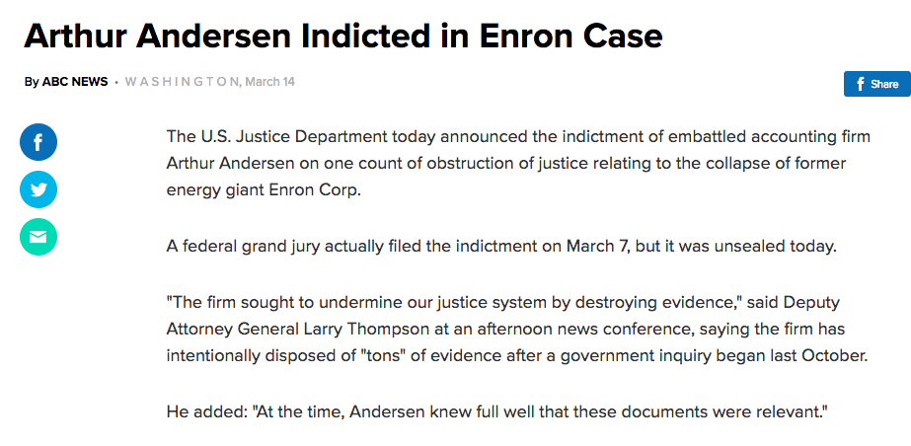
GOVERNANCE FAIL

Slide 3

EFFECTIVENESS = SHARED UNDERSTANDING OF BOARD ROLE

Slide 4



ROLE OF THE BOARD OF DIRECTORS
1. RISK
2. STRATEGY
3. CEO PERFORMANCE
LEGAL
FINANCIAL
MARKET
OPERATIONS
MITIGATE RISKS TO THE ORGANIZATION
CAPITALIZE ON OPPORTUNITIES TO FULFILL THE MISSION
RESULTS
BOARD RELATIONS

Slide 5
SO, WHAT ARE THE BUILDING BLOCKS
OF AN EFFECTIVE BOARD?

Slide 6

COMPOSITION
INFORMATION
LEADERSHIP
PROCESS
DYNAMICS
BUILDING BLOCKS OF AN EFFECTIVE BOAD

Slide 7
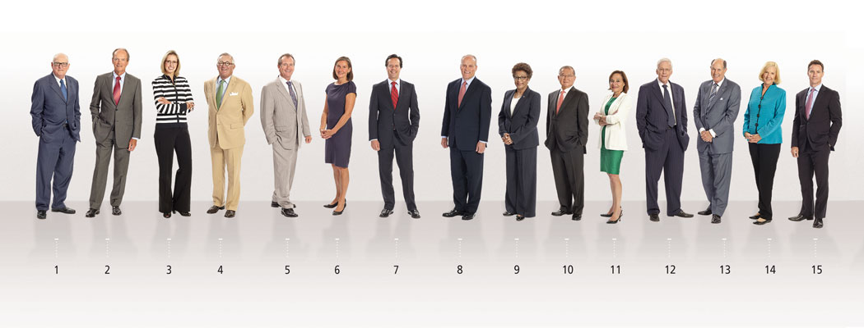
1
BOARD COMPOSITON
Do the Board’s skills and expertise match the risks and strategies of the organization?

Slide 8


BOARD SKILLS MATRIX
 | BOARD LEADERSHIP | PRIVATE BUSINESS | CORPORATE STRATEGY | TECHNOLOGY
Director A
Director B
Director C
Director D

Slide 9
2016 BOARD COMPOSITION WISH LIST
FOR NEW DIRECTOR BACKGROUNDS
Women | 64%
Active CEO / COO | 63%
Retired CEO / COO | 58%
Minority | 55%
Financial Expertise | 55%
Global Perspective | 55%
Technology Expertise | 44%
Specific Industry Expertise | 37%
Digital / Social Media Expertise | 21%
Regulatory / Government Experience | 19%
Marketing Expertise | 19%
Cybersecurity Expertise | 19%
Other | 8%
2016 SPENCER STUART BOARD INDEX

Slide 10

2
DECISION-MAKING INFORMATION
Does the information the Board receives support it’s ability to assess risk, set direction and lead the organization?

Slide 11
WHAT INFORMATION DO
DIRECTORS REQUIRE?
WHAT RISK INFORMATION?
  Legal, financial, market, operations
WHAT INFORMATION ON STRATEGY?
  Plans for mitigating risk
  Plans for capitalizing on opportunities
WHAT CEO PERFORMANCE INFORMATION?
  Targets, results, achievements

Slide 12
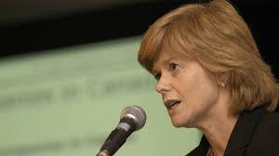

3
BOARD LEADERSHIP
Is effective leadership provided by the Board and Committee Chairs?

Slide 13
BOARD LEADERSHIP SKILLS
AND EXPERTISE
Governance and Role of the Board
Governance Process, Including Meetings and Decision Making
Leadership, Direction, Motivation
Knows the Business

Slide 14
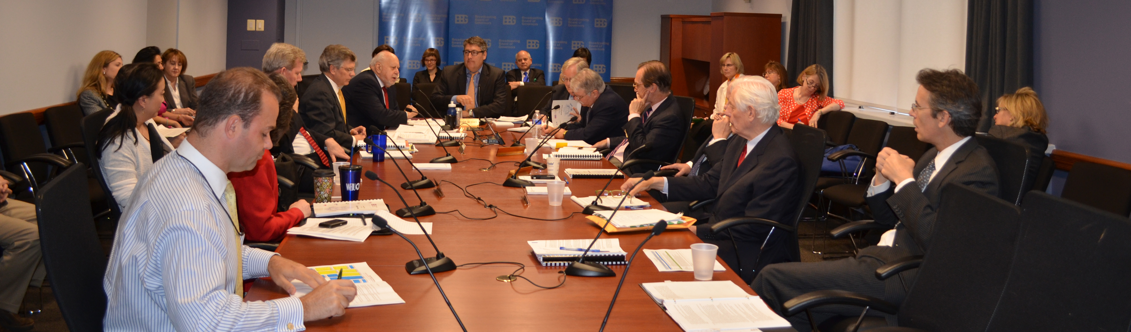
4
BOARD PROCESSES
How well do Board processes facilitate knowledge gathering, decision making, planning and execution of Board decisions?

Slide 15
KEY BOARD PROCESSES
Distribution of information
Board meetings and decision making
Board, CEO and other Assessments
Interaction with management

Slide 16
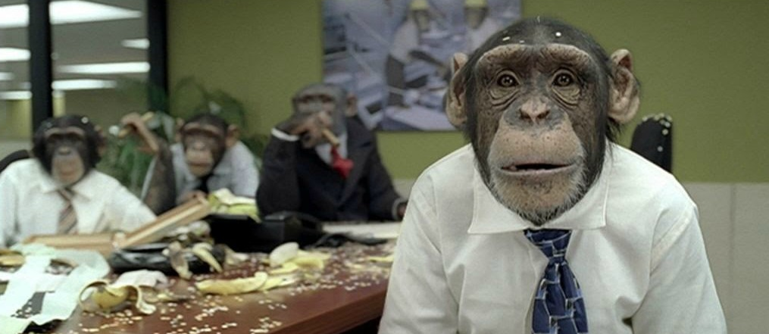
4
BOARD DYNAMICS
How well does the Board work together as a team and with management?

Slide 17
KEY BOARD DYNAMICS
Respect
Objectivity
Collaboration
Humility (/paranoia!)

Slide 18

MEASURING
BOARD EFFECTIVENESS

Slide 19
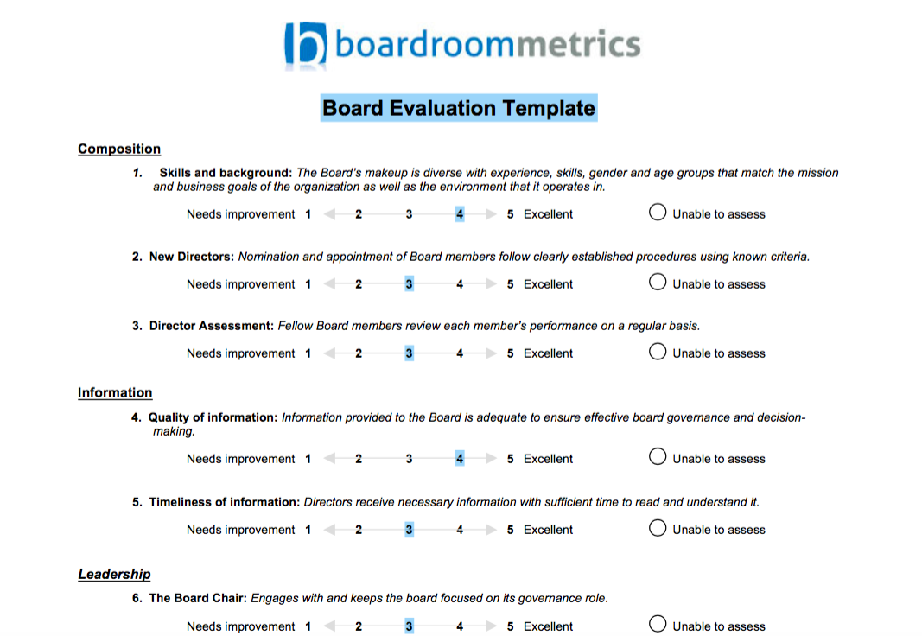

Slide 20

What if there wasn’t a Board of Directors? What would be different?
What are the key decisions made by the Board? What is the impact of those decisions?
In hindsight, what decisions would you make differently? How would it change the impact of the Board?
MEASURING
BOARD
IMPACT

Slide 21

THANK
YOU
www.boardroommetrics.com
info@boardroommetrics.com

