Slide 1
Aubin’s Axiom 76: You’d never devolve responsibility for your leadership communication in the boardroom……
So why is a kid running your CEO twitter account?
#leadership
#strategy
#business

Slide 2
AUBIN’S AXIOM 110:
If you have to consult a leadership app on your iPhone, you’re probably in the wrong line of work.
PRESS HERE TO RESIGN
#strategy
#leadership
#business

Slide 3
Aubin’s Axiom 279: Don’t be timid about refining your mission statement to accommodate subtle changes in your strategic environment.
#leadership #strategy #business

Slide 4
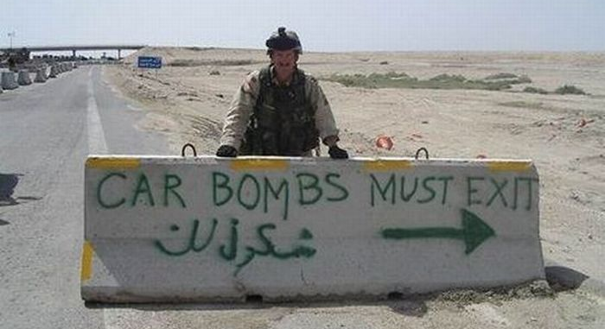
Aubin’s Axiom 242: Never argue with success. If it’s stupid and it works, then it’s not stupid.
#leadership #strategy #business

Slide 5
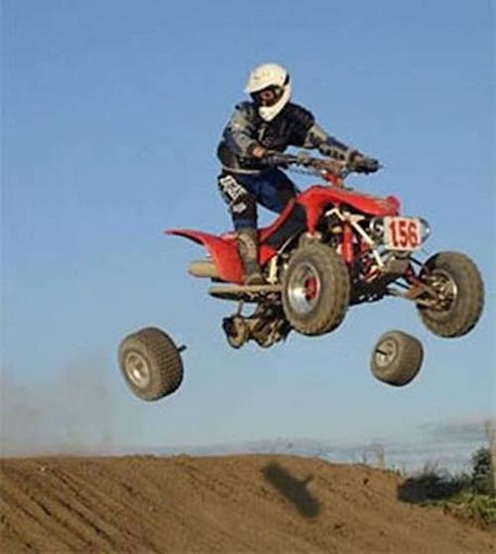
Aubin’s Axiom 243: Hindsight is a useful practice ...
…. but foresight is a far more practical one.
#leadership #strategy #business

Slide 6
Aubin’s Axiom 49: If you have to think twice about whether you are doing the right thing….
…. you probably aren't.
#leadership
#integrity
#strategy
#business
www.stratredteam.com

Slide 7
Aubin’s Axiom 26: Understanding your adversary’s available courses of action is fundamental to determining your own viable courses of action.
Photo: Roger Nilsson
#leadership #strategy #business

Slide 8
Aubin’s Axiom 132:
Don’t let people bring the following list of items to strategic planning sessions:
1. Org Charts.
End of list.
Bovine
HQ
Cows for
eating
Mad
Cows
Sacred
Cows
Cows for
milking
Annoyed
Cows
#strategy #leadership #business
Dog
Food
www.stratredteam.com

Slide 9
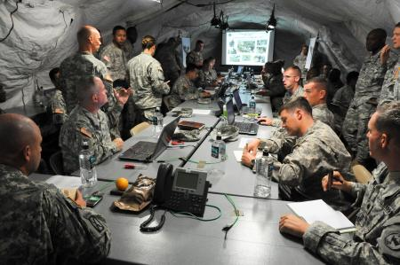
Aubin’s Axiom 239: In business as in battle, effective teams are comprised of a careful blend of …..
FINDERS…..
…..MINDERS
….and GRINDERS
“Finders, Minders & Grinders” c/o Dr Paul Roman, Queen’s School of Business.

Slide 10
STRATEGIC RED TEAM CONSULTING
Aubin’s Axiom 257: In business, as in battle,
effective leadership isn’t practiced from the
confines of your swivel chair.
#leadership
#strategy
#business
www.stratredteam.com

Slide 11
Aubin’s Axiom 159:
In business, as in battle, sometimes your mission will simply suck.
That doesn’t imply it’s not vital though.
#leadership
#strategy
#business

Slide 12
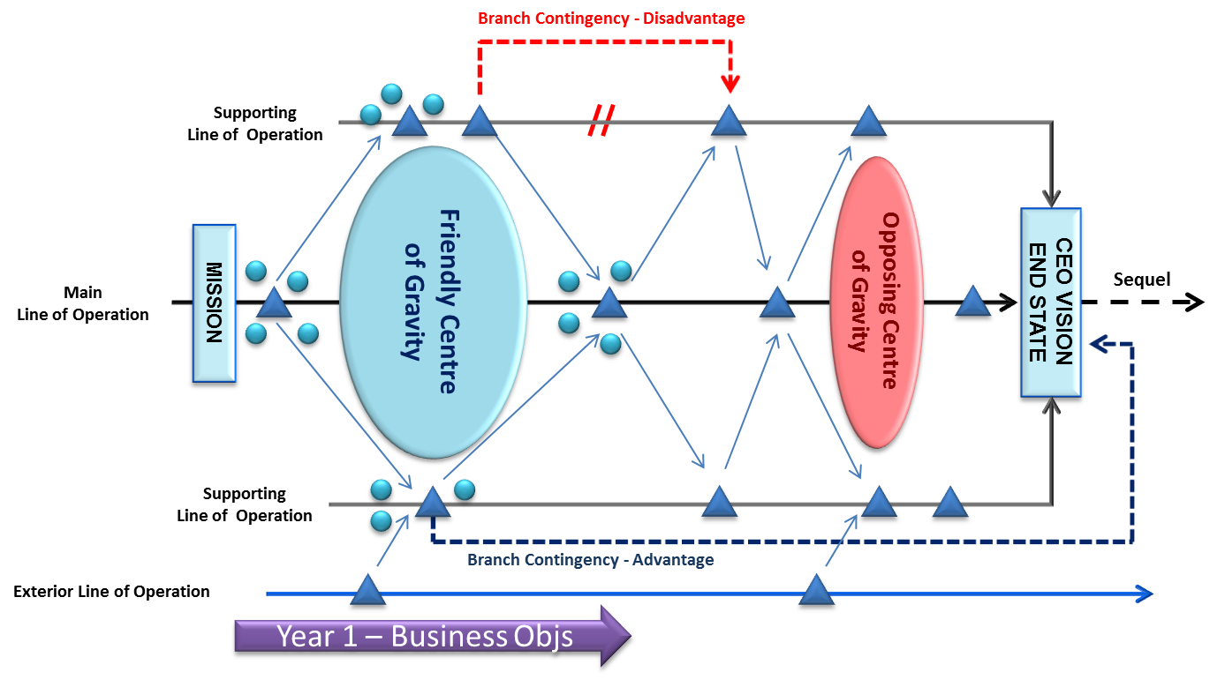
Aubin’s Axiom 40: There are many elements to creating and executing a coherent strategy:
Leadership
is Number 1.
Everything else
is Number 2.
#leadership #strategy #business

Slide 13
Aubin’s Axiom 269: Contingency Plans (or Plans B) are not just for when you encounter obstacles – but also for when you achieve unexpected, or accelerated success.
Branch Contingency - Disadvantage
Supporting
Line of Operation
Friendly
Centre of Gravity
Opposing Centre of Gravity
Main LOO
CEO VISION
END STATE
Sequel
MISSION
Supporting
Line of Operation
Branch Contingency - Advantage
Exterior Line of Operation

Slide 14
Aubin’s Axiom 88: If you see a snake, do you KILL IT immediately……
…… or do you form a COMMITTEE TO STUDY SNAKES?
#strategy #leadership #business

Slide 15
Aubin’s Axiom 261: While the optimists, pessimists and realists in your C-Suite are debating about the whether the glass is half empty, or half full….
…… your competition drinks it.
#strategy #leadership #business

Slide 16
Aubin’s Axiom 55: In business, as in battle, the quality of your troops is your single best leadership credential.
#leadership
#strategy
#business
www.stratredteam.com

Slide 17
Aubin’s Axiom 281: Strategy without leadership is like a broken pencil.
Pointless!
#leadership #strategy #business

Slide 18
REST IN PEACE
Nortel
1895-2009
Canwest
1974-2009
Lehman Brothers
1858-2008
Circuit City
1949-2009
RIM / Blackberry
1985 - .
Aubin’s Axiom 156: Weak leadership, addiction to mediocrity, slaves to risk avoidance and wallowing in comfort zones are very popular themes in corporate obituaries.
#strategy #leadership #business

Slide 19
Aubin’s Axiom 272: Never waste your audience’s time with lazy, unimaginative or redundant communication.
#leadership #strategy #business

Slide 20
Aubin’s Axiom 179: Tolerating fools is not a quality of effective leadership. Rather, it's a symptom of lazy, or timid leadership.
#leadership #strategy #business
www.stratredteam.com

Slide 21
Aubin’s Axiom 224: When you treat people like human resources, they’ll act like human resources……
…. but, when you treat them like human beings….
#strategy #leadership #business

